Slide 1
Features of a Good Presentation
Team 3659 NeXt Gen

Slide 2
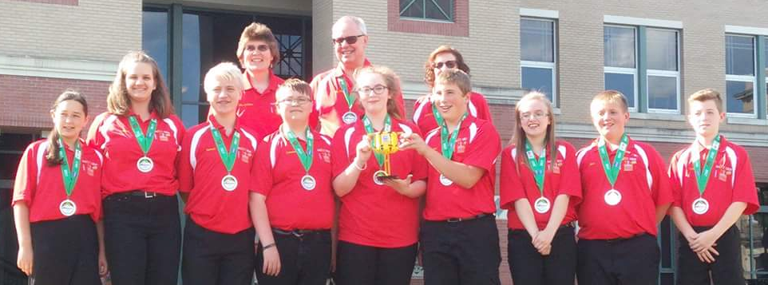
About The author
Middle school team from Garrett County, Maryland
13 years in FIRST LEGO League (including competing in International Tournaments)
First place 2013 Global Innovation Award for the Gramma Jamma
Top 20 GIA Semi-Finalist in 2017 for innovative solution, BeeHaven
First Place Innovative Solution at Mountain State Invitational in 2017

Slide 3
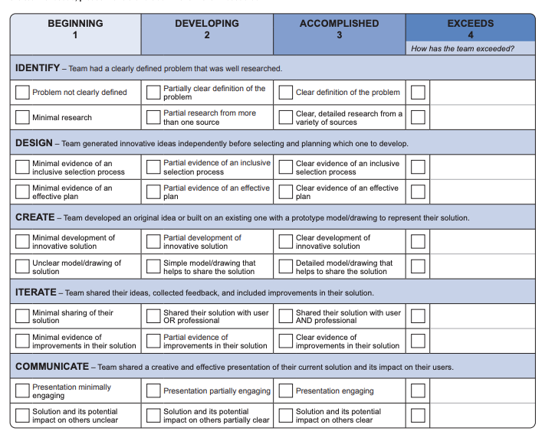
Start with the Project Rubric
Start by examining the FIRST LEGO League Innovation Project rubric.
We recommend writing a script for the presentation that includes everything that is required in the Project Rubric.
Highlight the 5 key areas – Identify, Design, Create, Iterate and Communicate
You must cover all 5 areas in your 5 minute presentation
You can watch our video of our research project presentation at https://youtu.be/lbN3kgpQIOU (Note: This video is for an older rubric)

Slide 4
IDENTIFY
Identifying a problem is the key step
Teams often try to skip this step and pick a solution first
Be sure you have a clear problem that you can articulate
You need to be able to explain why the problem you picked fits the Challenge prompt for the year
While the number of sources is not counted, judges are looking for a variety of high-quality sources

Slide 5
DESIGN
This section asks teams to come up with multiple ideas before picking one
Share with your judges a few of the ideas and how you decided on one.
You also need a plan. Plans can vary in type or style, but you need to communicate what your steps were after picking the project
How did you split the work? How did you decide where to research? How did you go about completing the work?

Slide 6
CREATE
While your solution does not have to be completely original (can be an improvement), you need to show that you spent time thinking about the solution
Be prepared to share what it would take to make it a reality one day (have you thought of the materials, the costs, the process?)
A prototype model or drawing is required. It can be made from anything (no restrictions). The more detailed your prototype, the higher you score.

Slide 7
ITERATE
Iteration is a big component of the Innovation Project
Share the solution with as many people as possible – an expert and a user will get you more points
Get feedback and then improve your solution
Be very clear on whom you shared with and how your solution changed as a result.

Slide 8
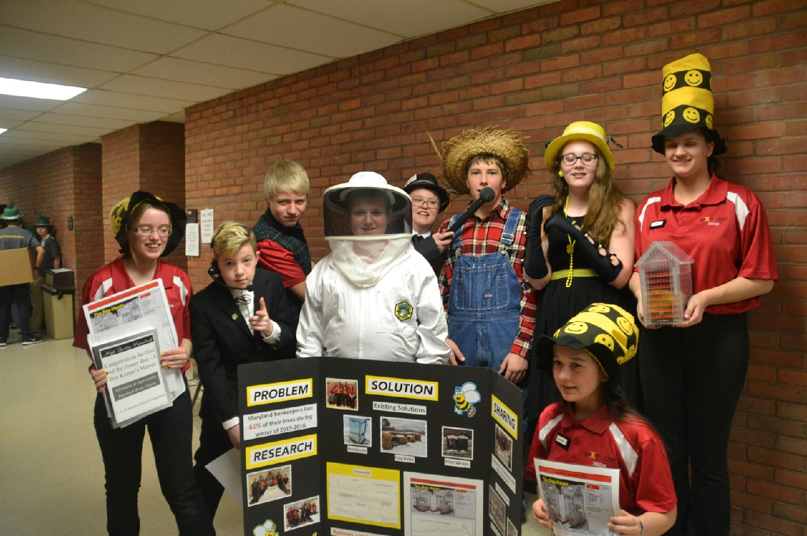
COMMUNICATE
To earn the most points in this section, you must clearly and effectively communicate all aspects of the rubric including the solution and its impact
Engaging presentations can be accomplished in many ways – some teams create a skit, for example
Try to memorize your script instead of reading it. Keep the lines short so that they are easy to memorize.
Make sure that everyone on the team participates.
When a team member is giving their lines, the whole team needs to be engaged.

Slide 9
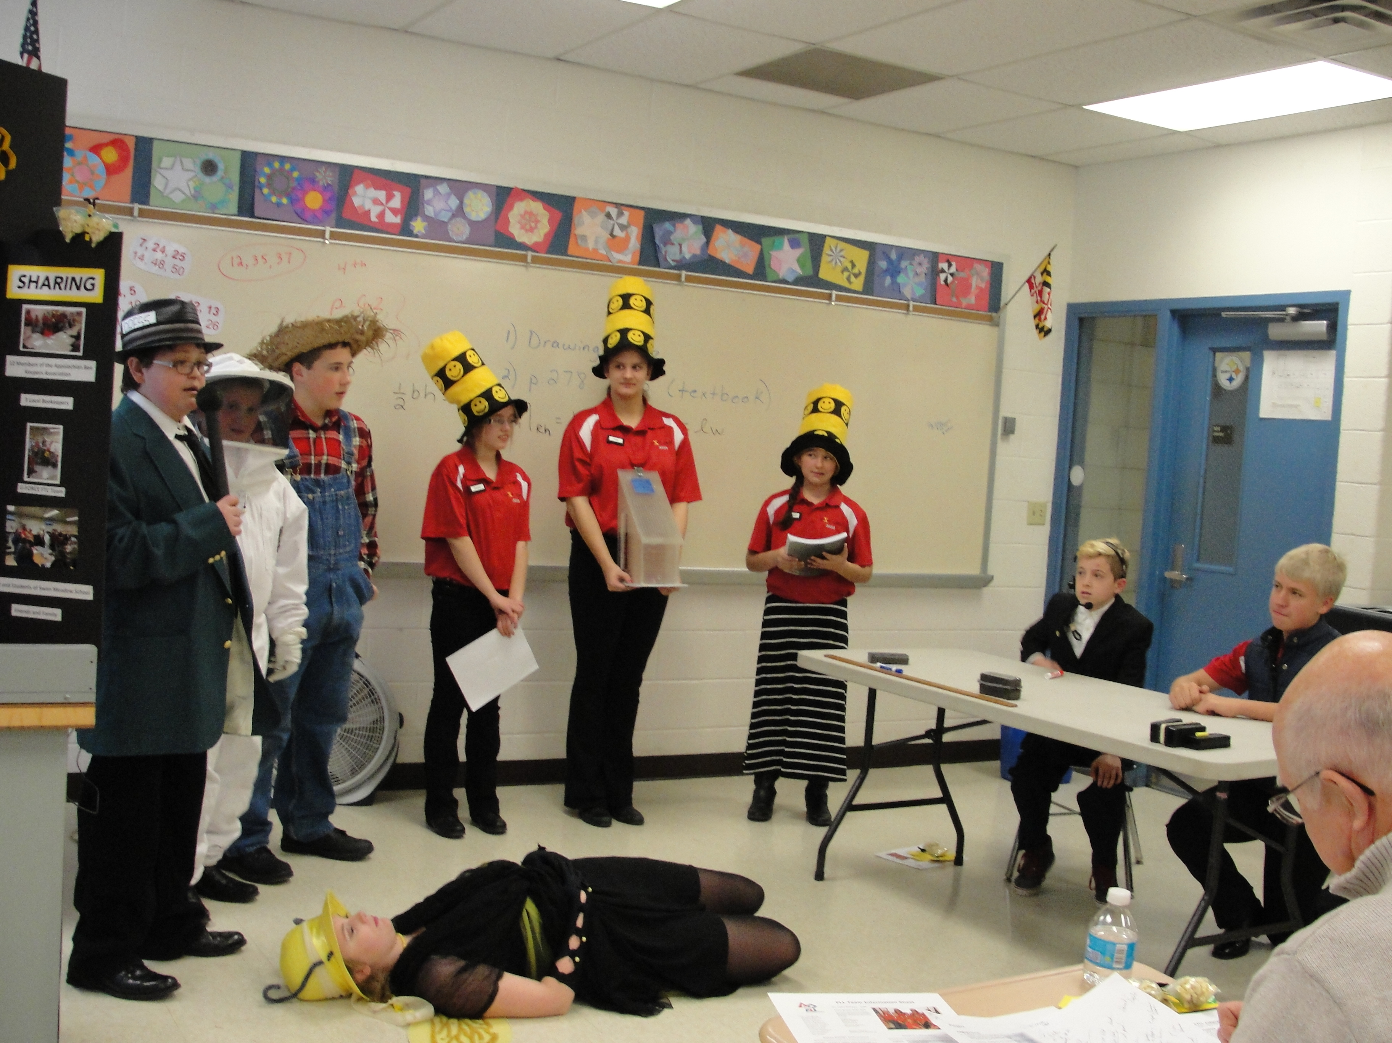
Judges’ Questions
After the presentation, judges ask questions. The judges may ask a specific team member or they may ask the whole team.
Choosing a “captain” for that judging session can be useful. The captain helps direct the questions and makes sure everyone on the team answers a question.
The captain does have to answer a question, too.
Whoever is the captain needs to know what each team member is most comfortable talking about. For example, say the judges ask a question about the existing solutions and why they don’t work. The captain could say, “ I know Sara researched that topic. Sara, would you like to answer the question?”
You can give the judges additional information if they don’t have any questions.
Everyone on the team needs to be able to answer questions and when a particular person is answering the entire team should be engaged

Slide 10
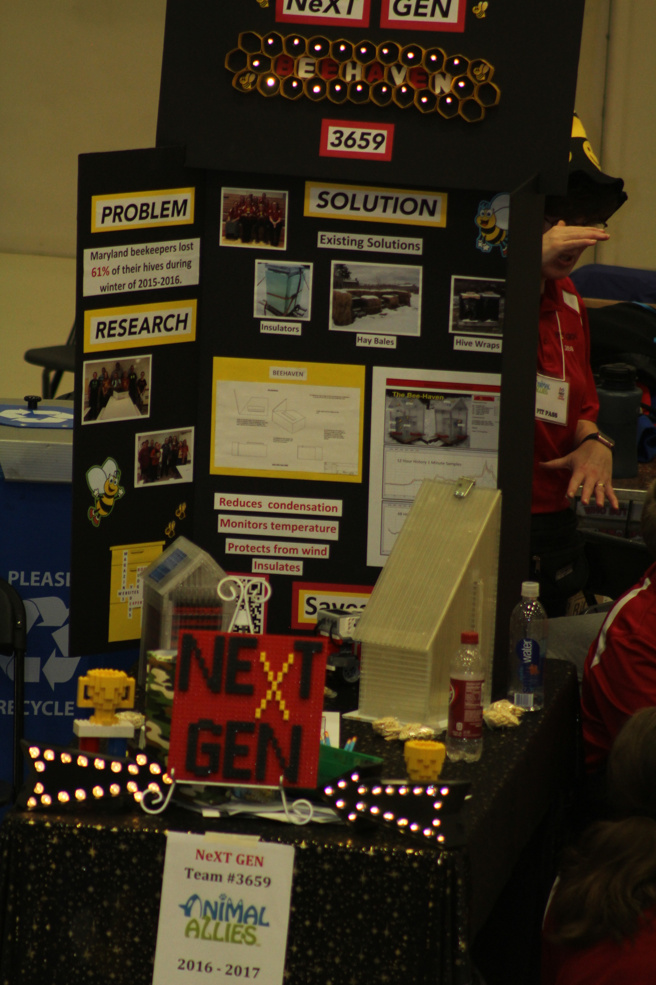
Display Boards
Having a display board at the pit area sparks conversation and can useful if a judge visits. The team can bring this display board into judging as well.
The display board can be used to explain the team’s research project.
We recommend using the research project rubric to help in the design layout of the board.
Draw the layout of the display board and plan out where certain information needs to be.
Include several photos of the team and the solution.
Typed descriptions enhance the look of the display board.
Tip: Use both sides of the board to allow for more information.

Slide 11
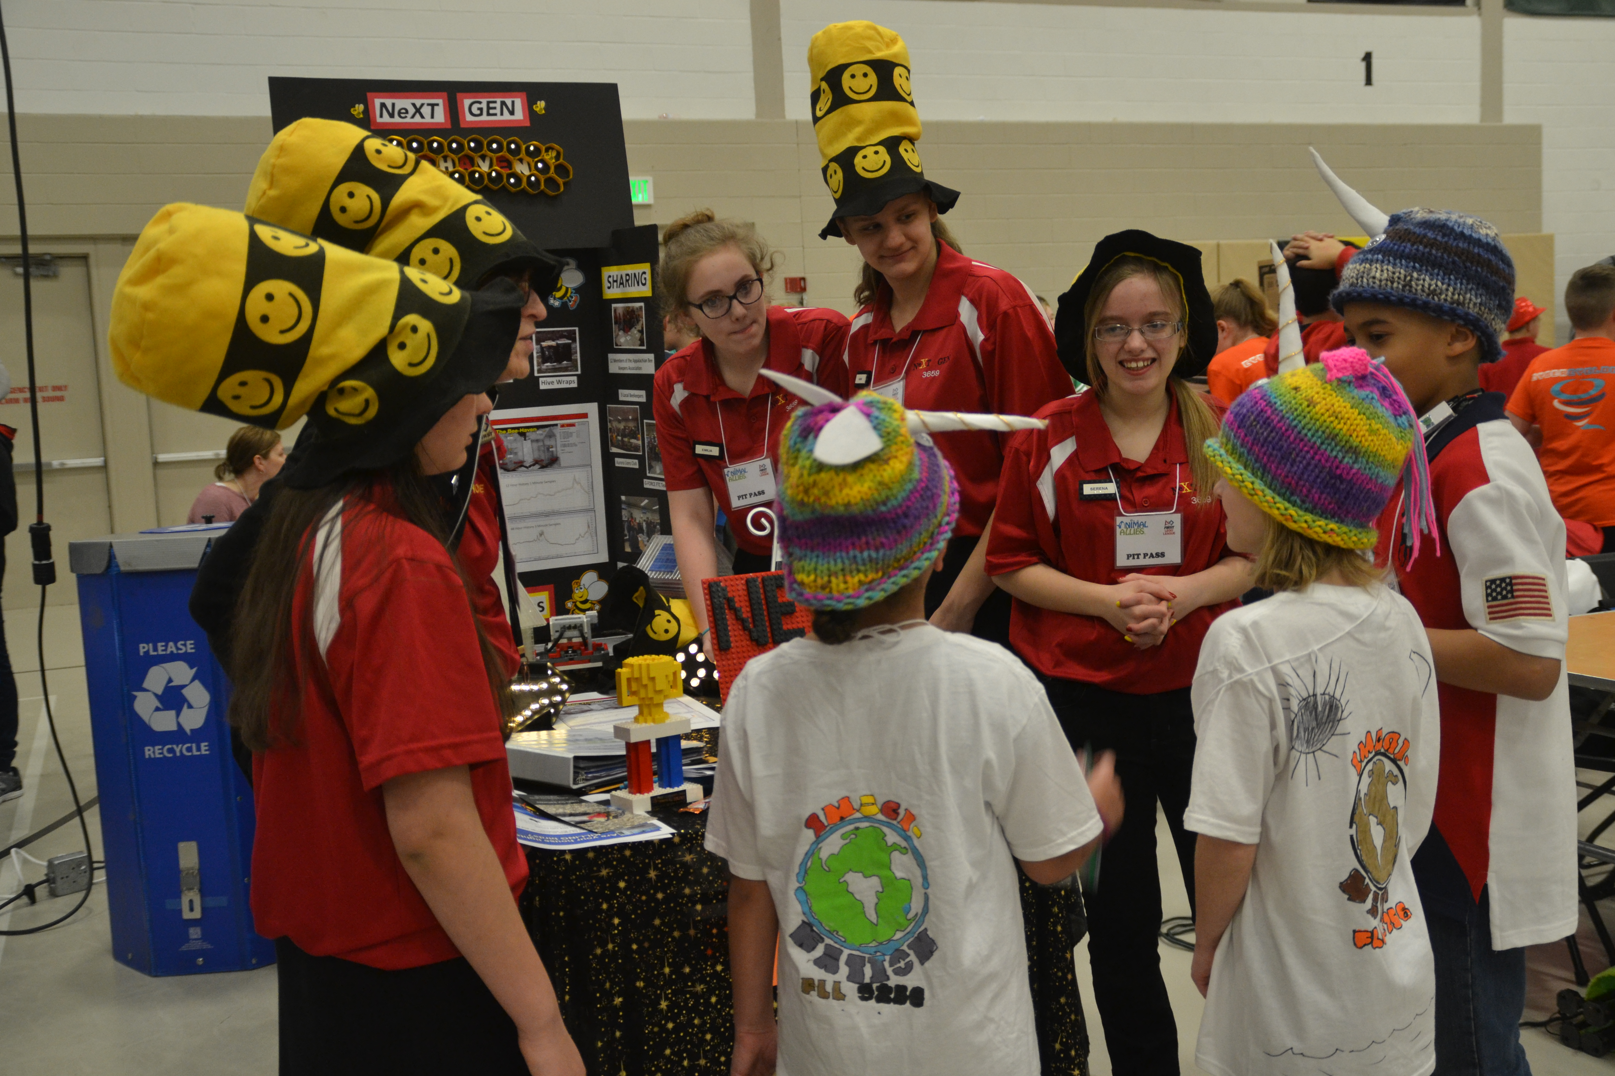
Team Notebook
A team notebook is a good way for other teams, judges, and visitors to get to know the team. The team can bring their notebook into judging to show the judges. It’s nice way to remember the season, too.
Here are some things you might include in your team notebook:
Introduction to the team members/coaches/mentors
Photos from competitions
Information about the project
Photos and description of the team sharing and demonstrating their project
Documentation about the solution development
Judges handouts (not allowed in some areas)
Thank you letter to sponsors
Marketing plan
Newspaper articles about the team

Slide 12
Judges Handouts
Teams can create handouts to give to their judges where allowed.
Judges handouts can be used to highlight the main points of the team’s presentation and to remind the judges of the team
Design the judges handouts to be a quick reminder of the presentation
Do not include long paragraphs explaining the team’s project
Consider the judging rubric when designing the judges handouts
Be creative! For our Animal Allies season, we made hexagon shaped handouts to represent honeycomb since our project was related to bees.

Slide 13

Credits
This lesson was written by Team 3659 NeXT GEN
You can contact Team 3659 NeXT GEN through their Facebook page: Garrett County FIRST LEGO League Team 3659.
More lessons available at www.ev3lesssons.com and www.flltutorials.com

